Slide 1

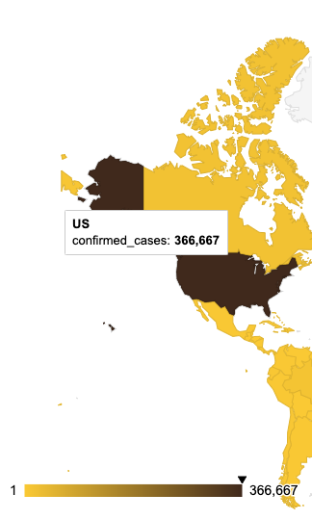
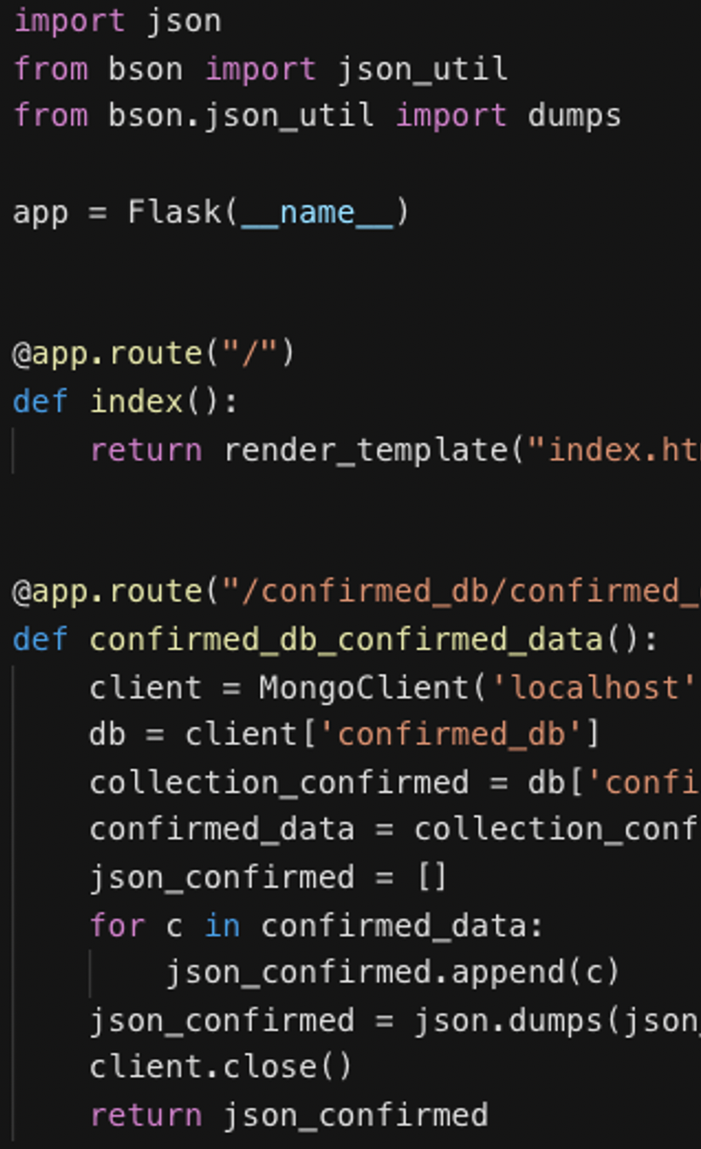
Visualizing the COVID-19 Pandemic
The Story
The Map
The Stack
Alexis Perumal
Grant Thompson
Arundhati Chakraborty
UCSD Data Science and Visualization Boot Camp, April 7, 2020

Slide 2
Visualizing the COVID-19 Pandemic
The Story
The Map
The Stack
Alexis Perumal
Grant Thompson
Arundhati Chakraborty
UCSD Data Science and Visualization Boot Camp, April 7, 2020

Slide 3
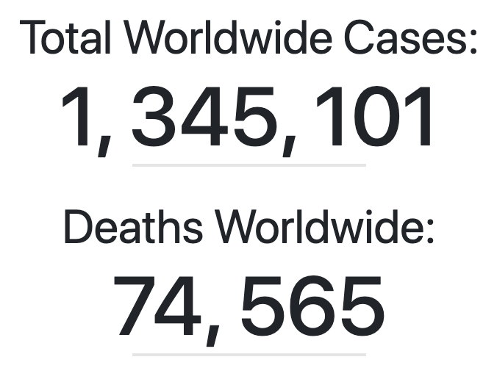
Covid-19 Pandemic As of 4/6/2020…
Source: Johns Hopkins University, 4/6/2020

Slide 4
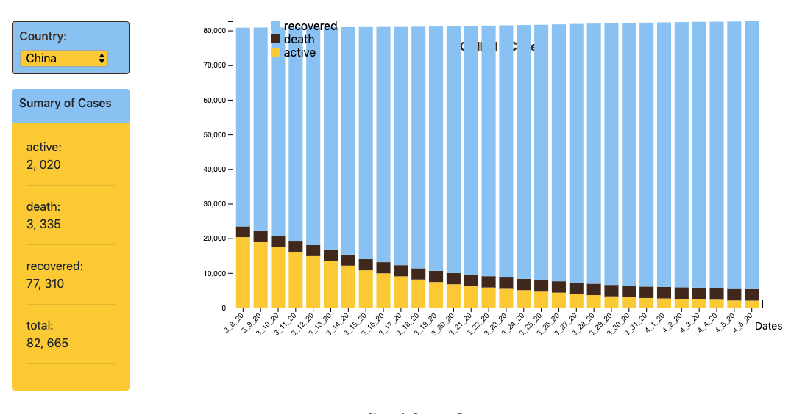
As of 4/6/2020… China is recovering,
Source: Johns Hopkins University, 4/6/2020

Slide 5
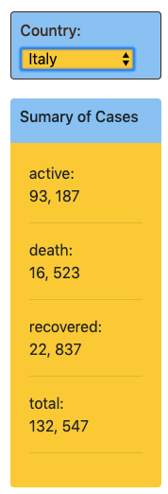
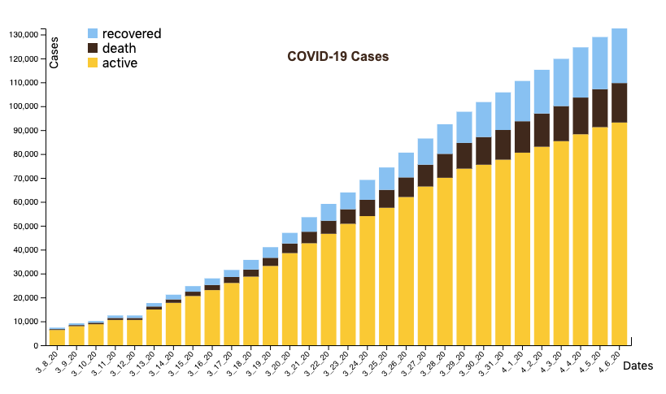
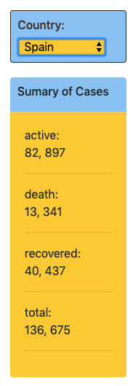
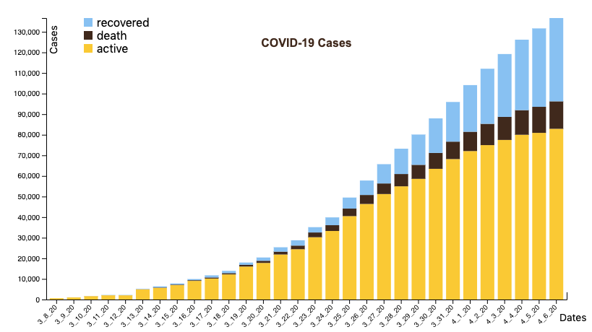
As of 4/6/2020… Italy and Spain are still suffering,
Source: Johns Hopkins University, 4/6/2020

Slide 6
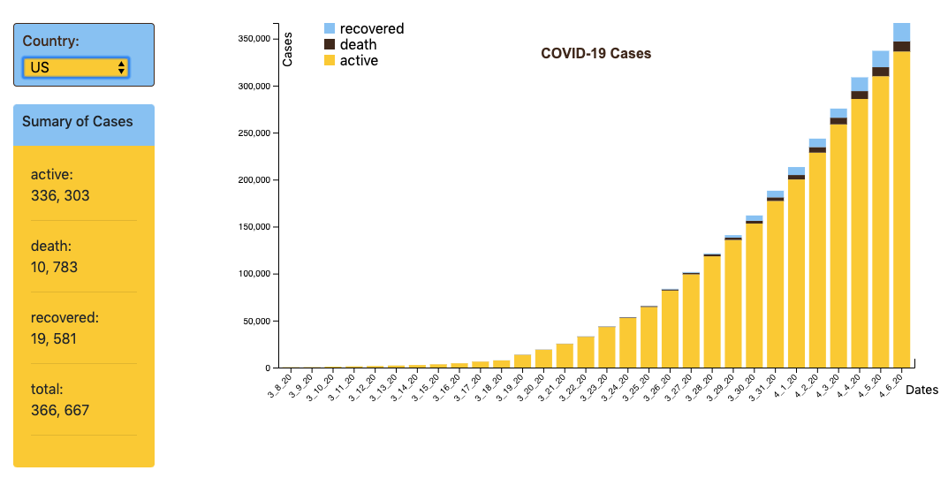
As of 4/6/2020… the US leads with over 300k cases,
Source: Johns Hopkins University, 4/6/2020

Slide 7
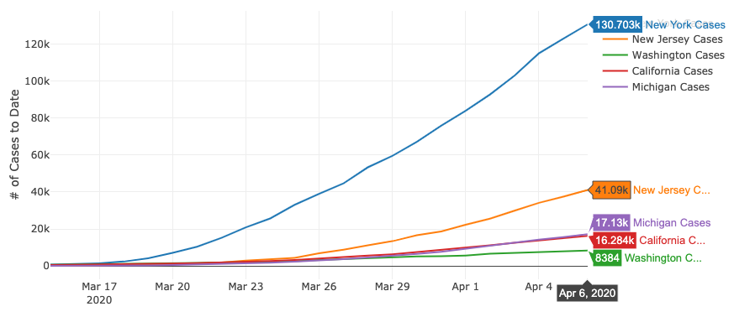
As of 4/6/2020… New York is the US epicenter.
Source: New York Times, 4/6/2020

Slide 8
Lots of questions…
What can we expect?
How long will this go?
Have we peaked?

Slide 9
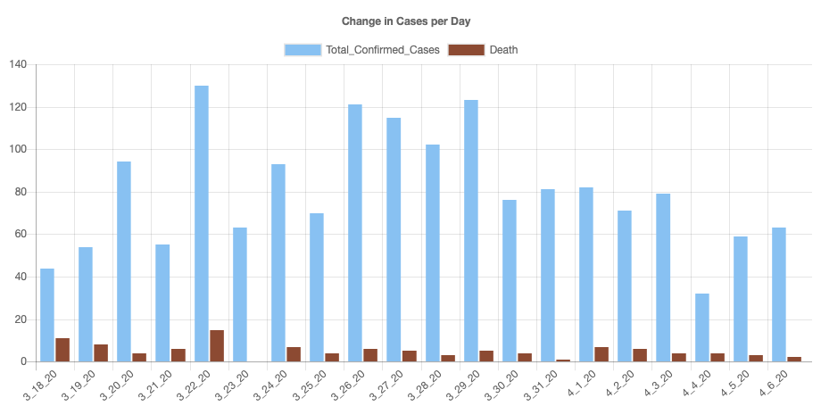
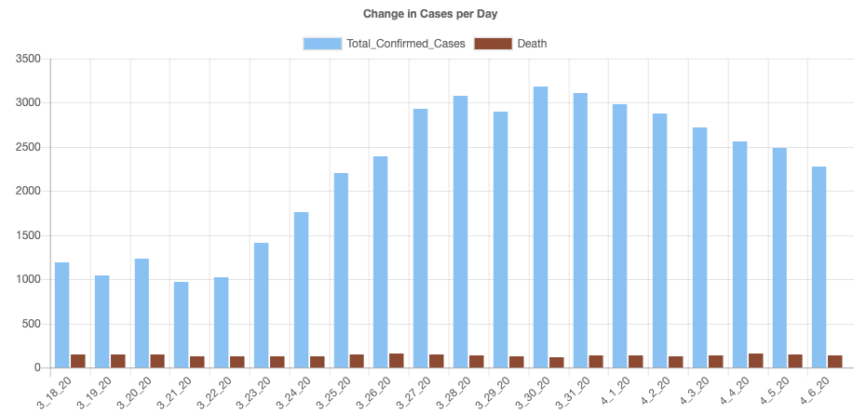
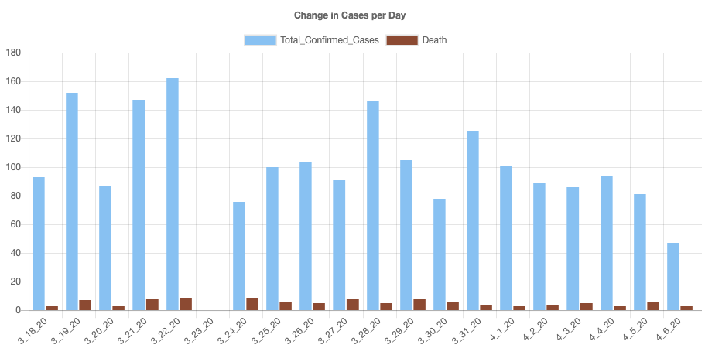
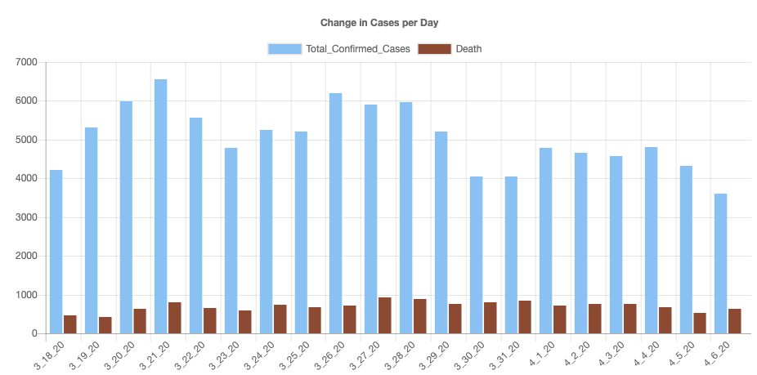
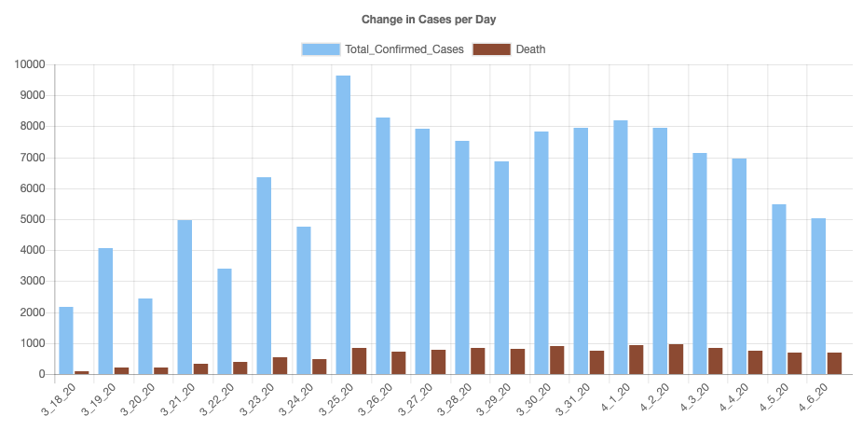
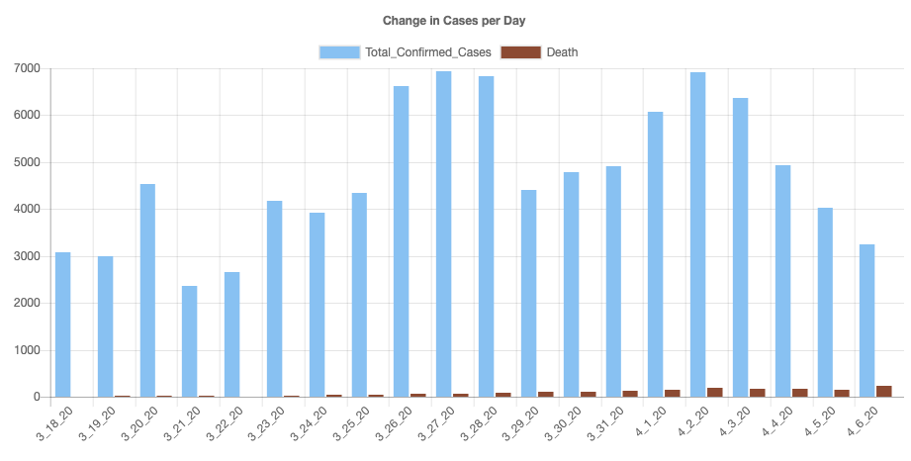
We can see in the data… Many countries have peaked!
30-day plots of new daily cases and deaths by country
China 2/13/20
Iran 3/30/20
South Korea 3/22/20
Italy 3/26/20
Spain 3/22/20
Germany 4/2/20
Source: Johns Hopkins University, 4/6/2020

Slide 10
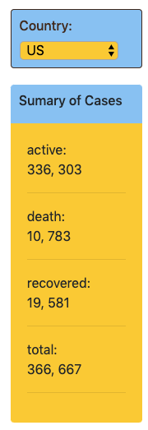
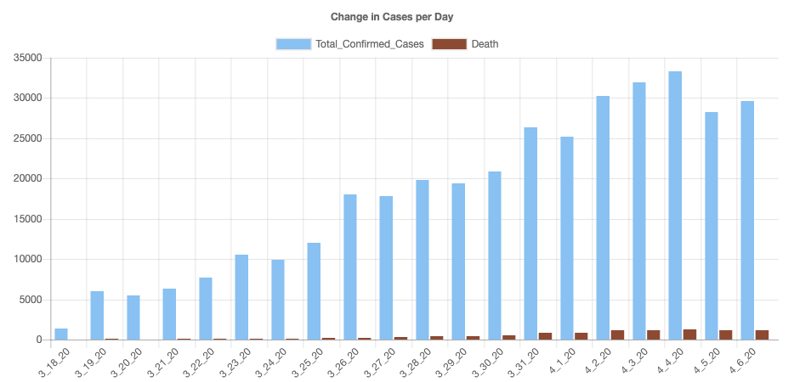
We can see in the data… The US may have just peaked,
Source: Johns Hopkins University, 4/6/2020

Slide 11
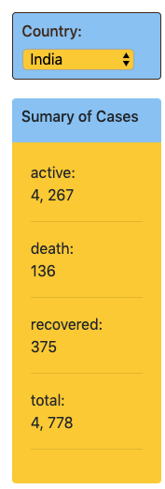
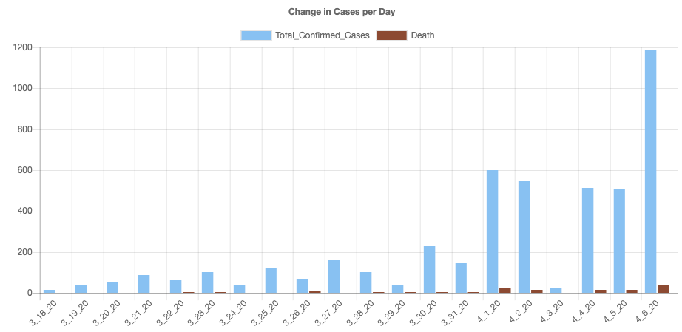
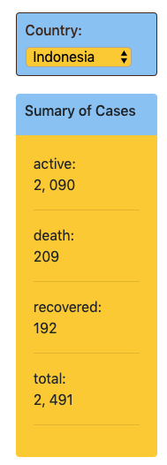
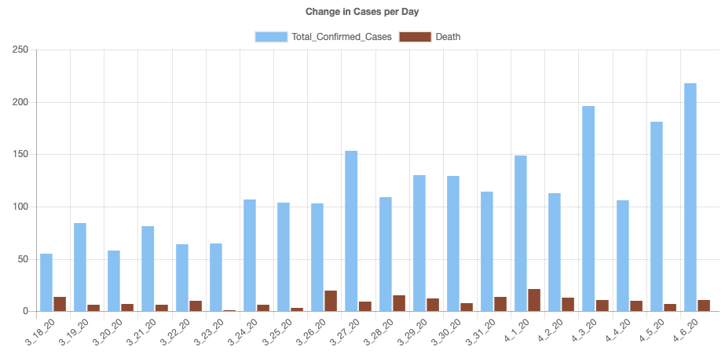
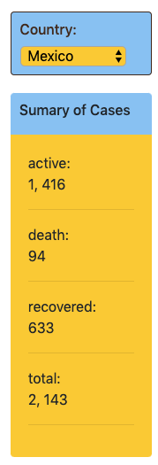
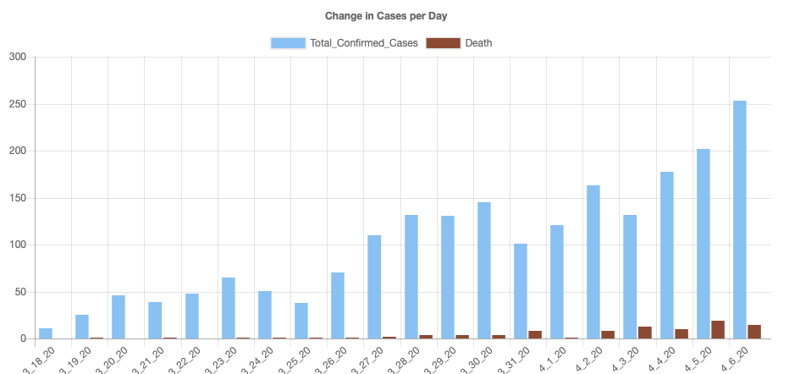
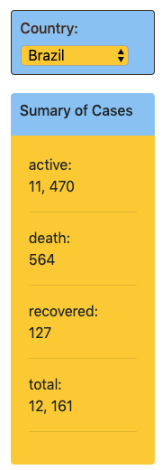
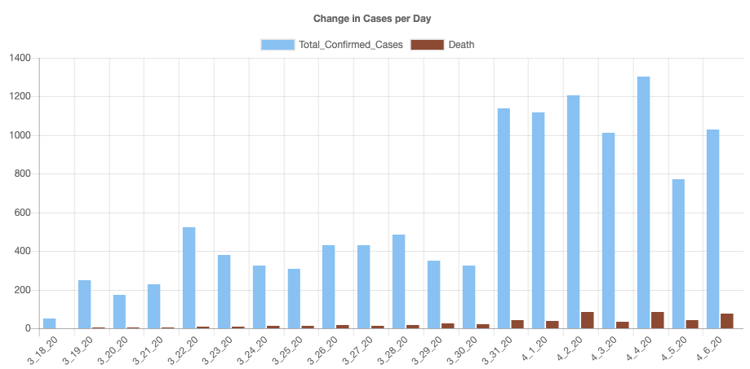
We can see in the data… but many countries are still rising.
Plots of new daily cases and deaths by country
India
Indonesia
Mexico
Brazil
Source: Johns Hopkins University, 4/6/2020

Slide 12
Visualizing the COVID-19 Pandemic
The Story
The Map
The Stack
Alexis Perumal
Grant Thompson
Arundhati Chakraborty
UCSD Data Science and Visualization Boot Camp, April 7, 2020

Slide 13
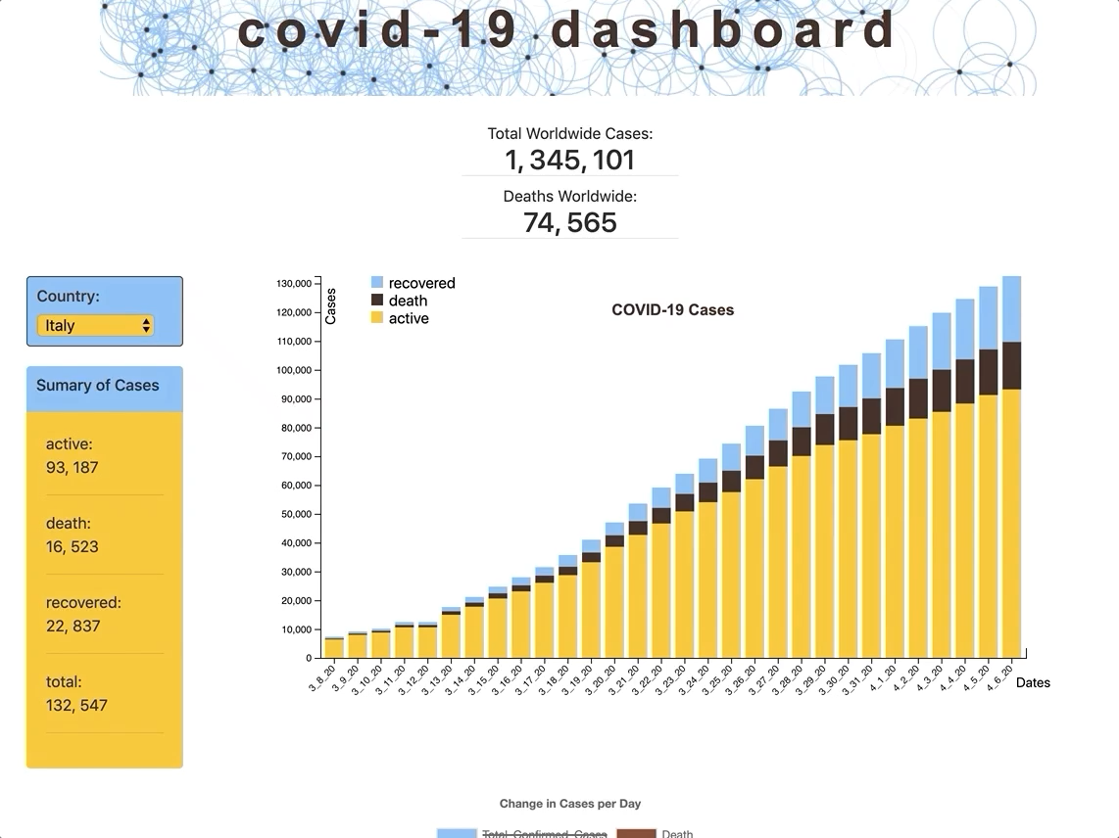
https://alexisperumal.github.io/covid-19/

Slide 14
Grant’s slides here.

Slide 15
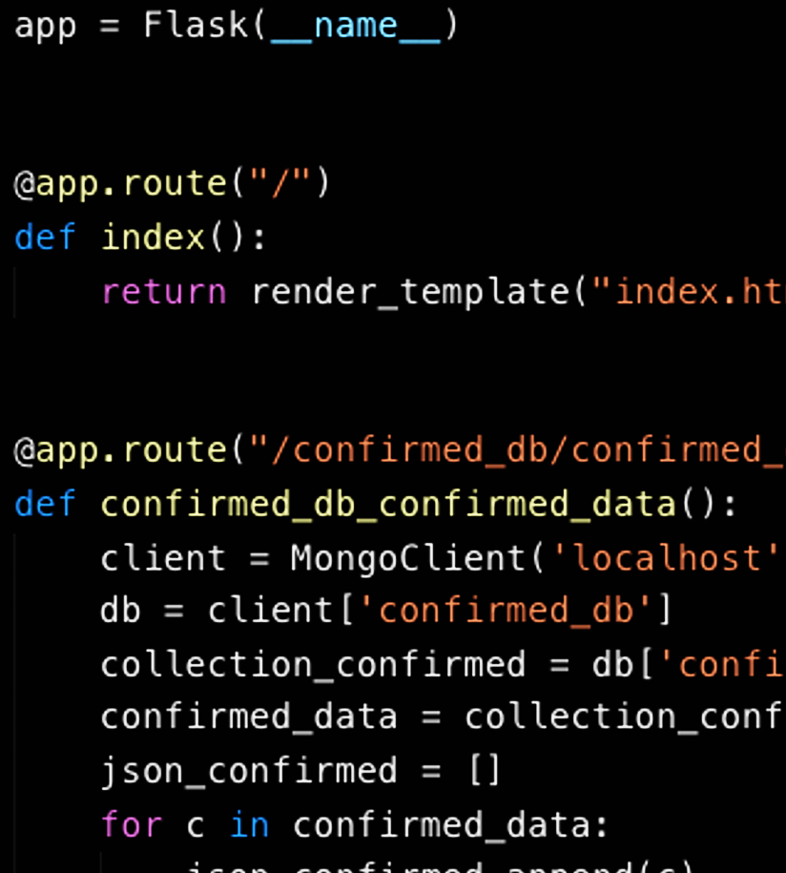
Visualizing the COVID-19 Pandemic
The Story
The Map
The Stack
Alexis Perumal
Grant Thompson
Arundhati Chakraborty
UCSD Data Science and Visualization Boot Camp, April 7, 2020

Slide 16
Libraries:
D3, Leaflet, Plotly, DC charts, Google Charts (visualization)
Axios (library to call Promises in js), Lodash (helper functions)
pymongo to interact with MongoDB (Notebook)
Flask to build the server and routing
utility files in python to grab csv and convert to json before pushing it to database
https://alexisperumal.github.io/covid-19/

Slide 17
Style Guide

Slide 18
Initial Wireframe

Slide 19
Getting and understanding the data
After downloading the csv files from the JH and NYT github page, used python script to grab the files and convert to json.
The attributes being used is :
time series dates till now, Country, Provice_State, Counties, confirmed cases, Death and Recovered.
Now that we have the data, next step is storing and querying the data using MongoDB :
- separate databases for confirmed, deaths, recovered global data till date
- separate database for confirmed and deaths for United States till now
- separate database for counties and States of US
- Used PyMongo for connecting to MongoDB and querying the data

Slide 20
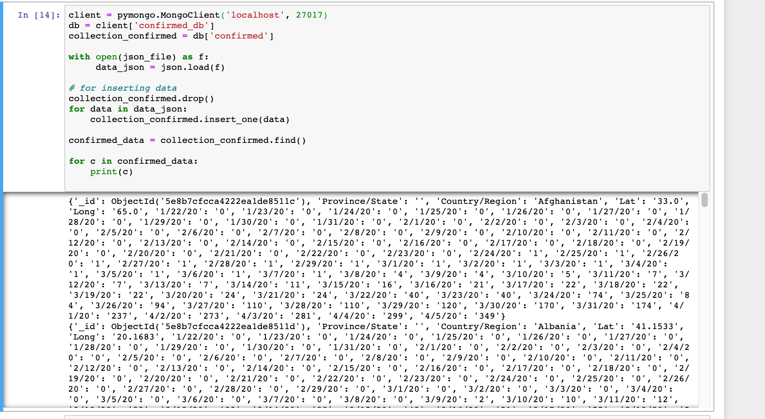
Storing the data in MongoDB and Interacting with database using PyMongo

Slide 21
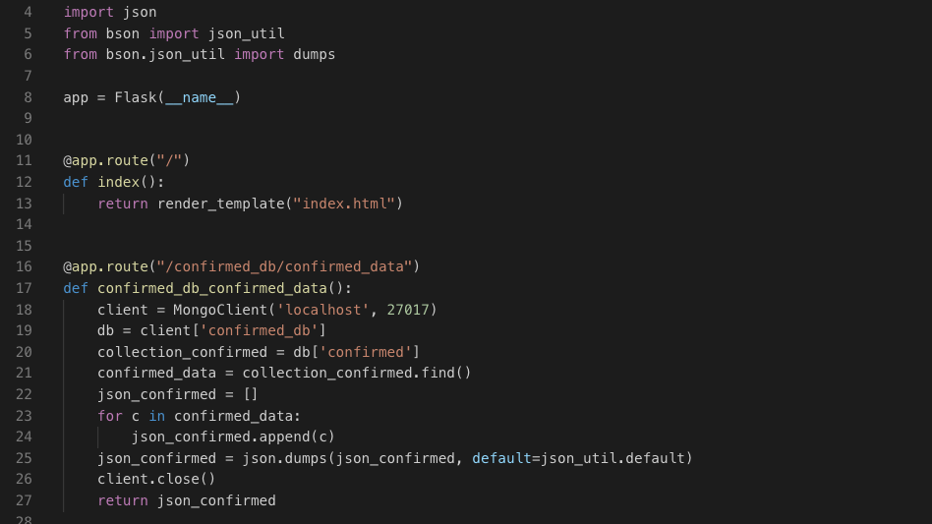
Building the server and Routes
We are using Python Flask for building a server that interact with MongoDB and render the html page that contains our charts. Modifying app.py folder to include the MongoDB query to retrieve all the records from MongoDB along the attributes using separate routes for each database.

Slide 22
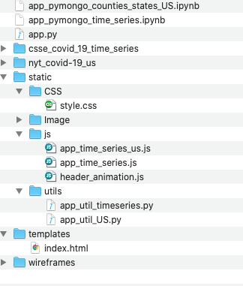
Front-end side preparation
Now that we have the server side code and the MongoDB query ready, we will start building the front end code.
For building the charts, we will be mainly using these list of Javascript libraries d3.js, Leaflet.js, Plotly.js, Google charts, dc Charts ( for filtering the data set) and D3 to do header animation
We will also be using Bootstrap for responsiveness, CSS for styling
Below is the folder structure of our project :

Slide 23
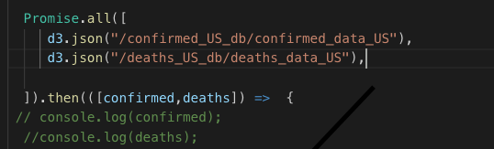
Building the charts
D3.json () promise calls to get the data from the routes to create individual charts :

Slide 24
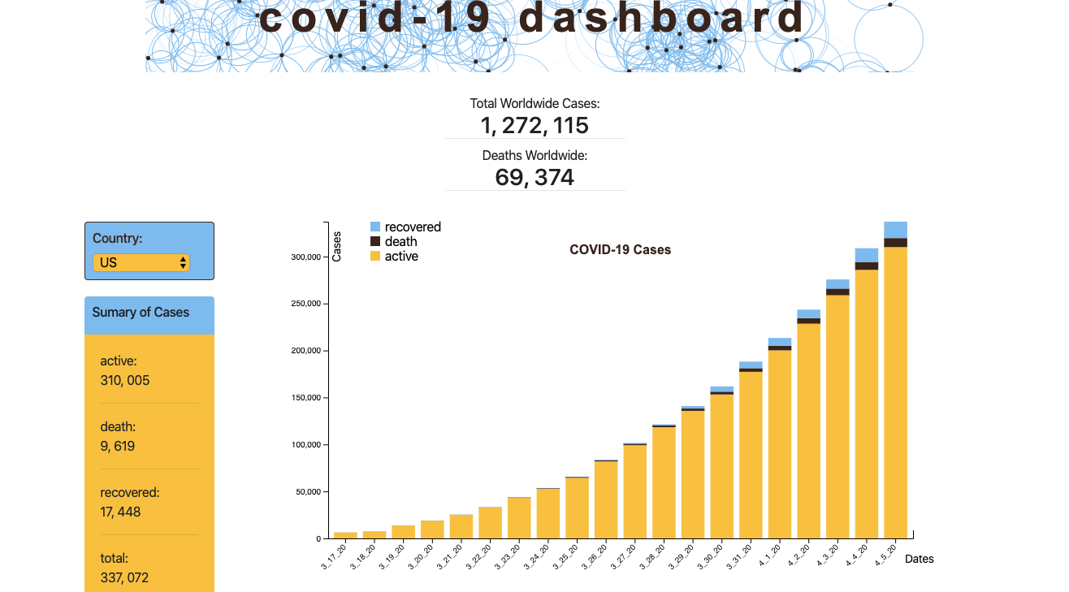
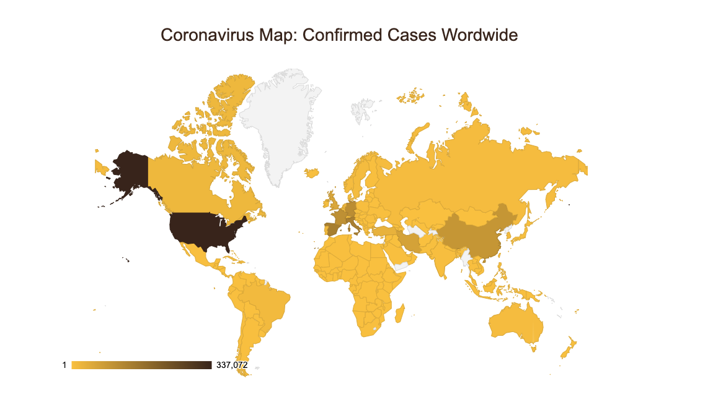
Building the charts ( continued)

Slide 25
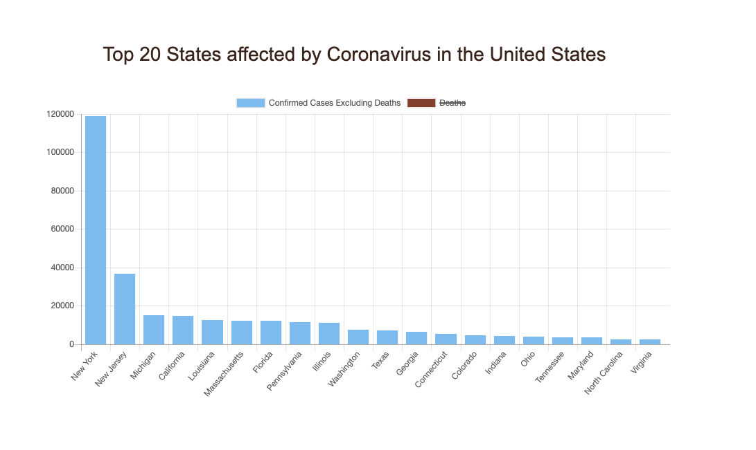
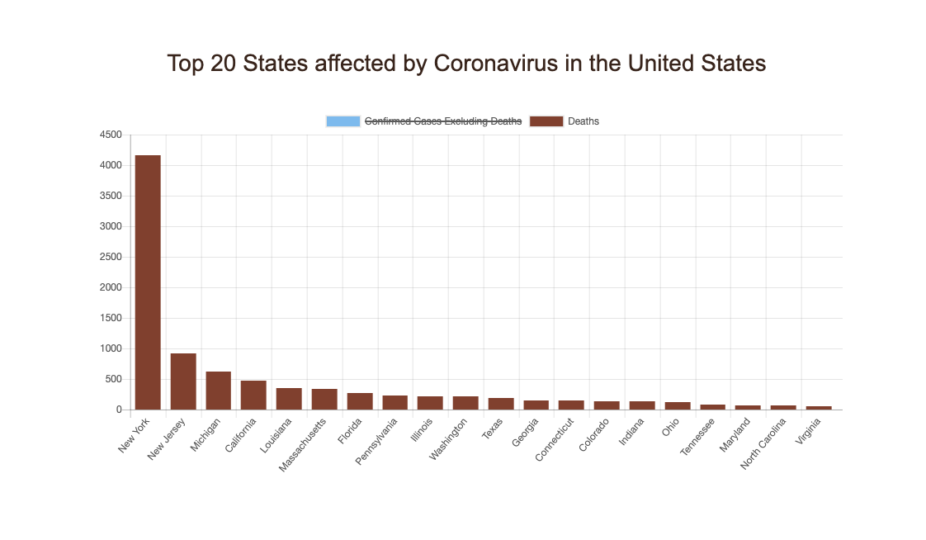
Building the charts with filtering ( continued)

Slide 26

Source: Johns Hopkins University, 4/6/2020

